Slide 1

DBMS Mini Project
Product MANAGEMENT SYSTEM

Slide 2
Employee:
With
More Information
Enters
New
Registers
Old
Performs Operation
Manages Products

Slide 3

Client:
Employee
New
Sell Products
Registers
Old
Sell Products
Managed By Employee

Slide 4
Products:
Employee
New
Products
Registers
Takes In
Old
Takes In
Shipment

Slide 5
Warehouse
To Market
Online
To Store In Different Locations
To Registered Users
For Selling

Slide 6
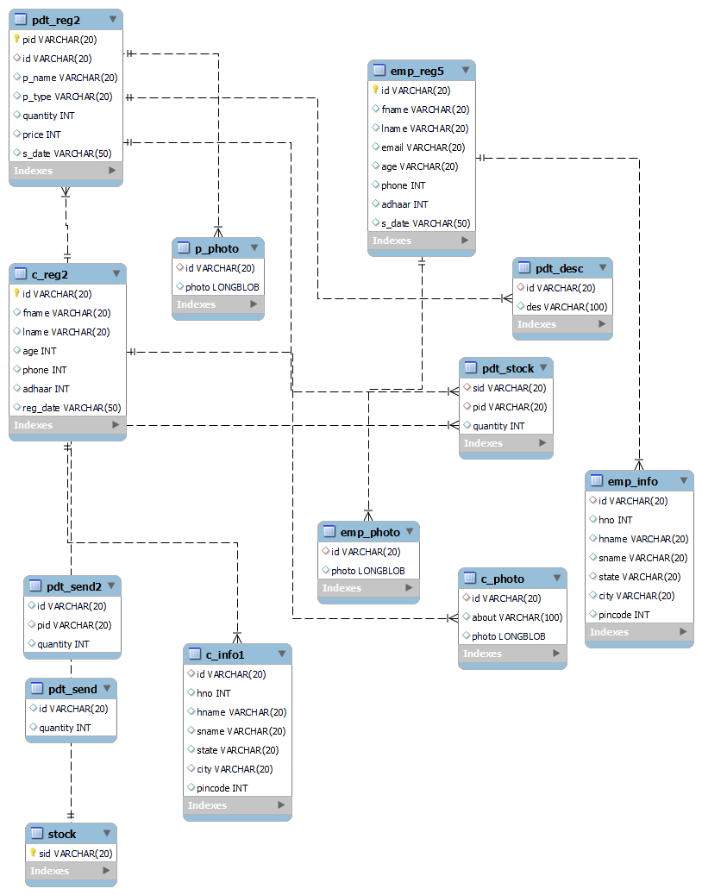

Slide 7
Thank You 😄😄😄

